Slide 1
Use Cases
Modeling Scenarios

Slide 2
Use Cases
Interaction between a user and a system
A complete and meaningful use
Focus on value – how the system will be used to satisfy a specific user goal
Observable and testable functionality - “black box” view of the system
The first system functional decomposition
All use cases = {all things the system must do}
Understand the big picture

Slide 3
Use-Case Modeling Phases
Three phases of requirements analysis:
Model the user roles – detailed actor descriptions
  Identify user goals for system interaction
Model (specify) requirements as use cases
  Use case diagrams – for context and reference
  Use case descriptions
Model use-case realizations
  An interaction of objects that realize the requirements
  Class diagrams and object interaction diagrams
  (Also known as robustness analysis, use case analysis, task modeling, or scripting)

Slide 4
UML Use-Case Modeling
An actor represents anything that interacts with the system
A use case is a set of system actions that yields an observable result of value to a particular actor
<<Actor>>
Actor
People, external systems, devices
UseCase
UseCase

Slide 5
Use-Case Diagram
A use-case diagram shows relationships between actors and use cases
  Relationships: “communicates with” (exchanges data, signals, events)
View Grades
<<Actor>>
CourseCatalog
Student
Register for Courses
System context
Login

Slide 6
Use Case Descriptions
For each use case describe functional steps in sufficient detail to …
  Enable (or represent) requirement specification
  Begin early design work
  Achieve stakeholder and user understanding and approval
The details …
  Name and description
  Actors
  Primary flow of events (as related stories)
  Secondary alternative and/or exception flow of events
  System preconditions
  System post conditions
  Supplemental information – non-functional requirements

Slide 7
“Why Use Cases at All?”
A good compromise – use cases are semi-formal, structured, but understandable stories (people like stories)
Use cases add value to analysis
  At first as a succinct outline of mainline features and capabilities (get your head around the functionality)
  Later a basis for innovation, extension, revision of requirements
Address exceptions – a large source of system complexity
Start functional decomposition that transitions to requirement specifications and early design
Good basis for pursuing related project information – estimates, plans, user interface design, software design, testing

Slide 8
But Use Cases Have Limitations
Too much detail – can be hard to work with
Developers need use case supplemental requirements to design
  Ancillary functionality such as system administration
  Non functional quality requirements and business rules
Functional decomposition guidance for design has limits
May not be as effective for non-user interactive systems
  Concurrent applications, batch processing, data warehousing, computational intensive, etc.

Slide 9
Use Case “Styles”
As Martin Fowler states “There is no standard way to write the content of a use case, and different formats work well in different cases.”
You can:
- Use a text paragraph style
- Table style
- Graphical
- Combo

Slide 10
Use Case Example - ATM
Withdraw
Cash
:
Bank Customer
Transfer
Funds
Bank
Deposit
Funds
Cashier
Refill
Machine
Maintenance Person

Slide 11
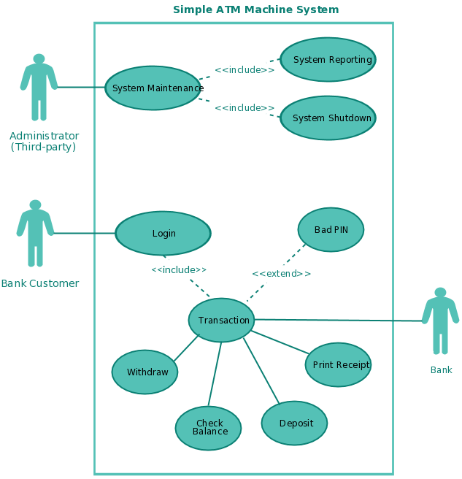
Other use cases & actors

Slide 12
ATM Model: Withdraw Cash Use Case
1 Brief Description
  This use case describes how the Bank Customer uses the ATM to withdraw money his/her bank account.
2 Actors
  2.1 Bank Customer
  2.2 Bank
3 Preconditions
  There is an active network connection to the Bank.
  The ATM has cash available.
4 Basic Flow of Events
  1. The use case begins when Bank Customer inserts their Bank Card.
  2. Use Case: Validate User is performed.
  3. The ATM displays the different alternatives that are available on this unit. [See Supporting Requirement SR-xxx for list of alternatives]. In this case the Bank Customer always selects “Withdraw Cash”.
  4. The ATM prompts for an account. See Supporting Requirement SR-yyy for account types that shall be supported.
  5. The Bank Customer selects an account.
  6. The ATM prompts for an amount.
  7. The Bank Customer enters an amount.
  8. Card ID, PIN, amount and account is sent to Bank as a transaction. The Bank Consortium replies with a go/no go reply telling if the transaction is ok.
  9. Then money is dispensed
  10. The Bank Card is returned.
  11. The receipt is printed
  12. The use case ends successfully

Slide 13
ATM Model: Withdraw Cash Use Case (2)
5 Alternative Flows
5.1 Invalid User
  If in step 2 of the basic flow Bank Customer the use case: Validate User does not complete successfully, then
  1. the use case ends with a failure condition
5.2 Wrong account
  If in step 8 of the basic flow the account selected by the Bank Customer is not associated with this bank card, then
  1. The ATM shall display the message “Invalid Account – please try again”
  The use case resumes at step 4
.
.
7 Post-conditions
  7.1 Successful Completion
  The user has received their cash and the internal logs have been updated.
  7.2 Failure Condition
  The logs have been updated accordingly.

Slide 14
Developing the Use Case Model
Steps
  Find Actors
  Find Use Cases
  Describe How Actors and Use Cases Interact
  Present the Use-Case Model in Use-Case Diagrams
  Package Actors and Use Cases
  Develop a Survey of the Use-Case Model
  Evaluate Your Results

Slide 15
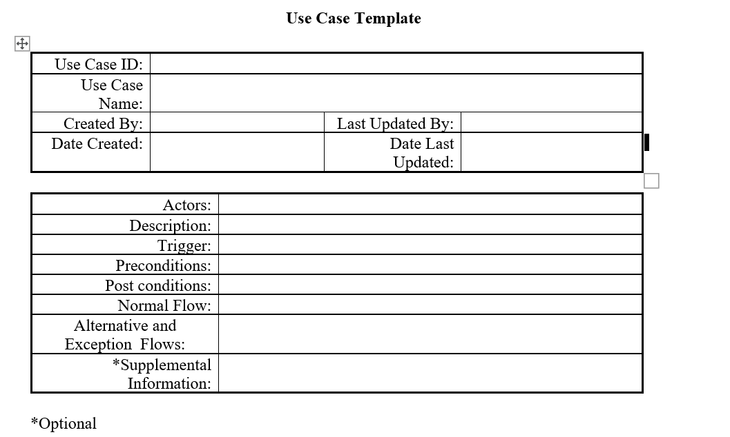
Template

